Slide 1
Energy A.I. Hackathon 2023
Team Drillpy
April 11th, 2023
Abraham Montes, Çınar Turhan, Mohammad Abdullah, Ethan Litchauer
Petroleum and Geosystems Engineering, Electrical and Computer Engineering

Slide 2
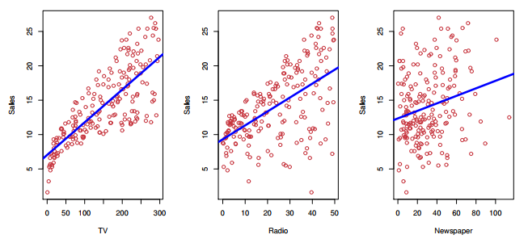
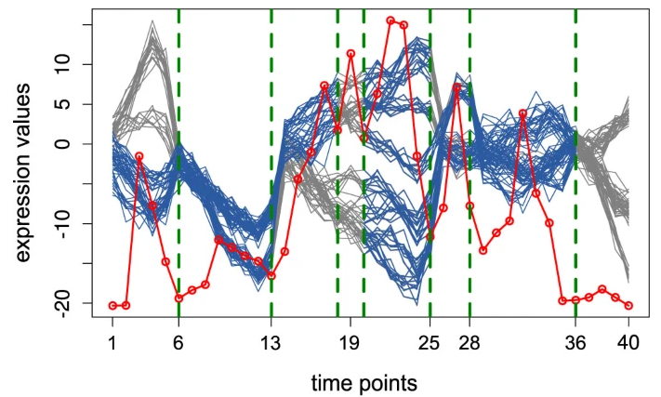
Agenda
Introduction
Why does it matter?
Work breakdown
Data is gold, right?
How we hacked it
How we would hack it again
Wrap up
[James et al 2017]
[Omranian et al 2015]

Slide 3
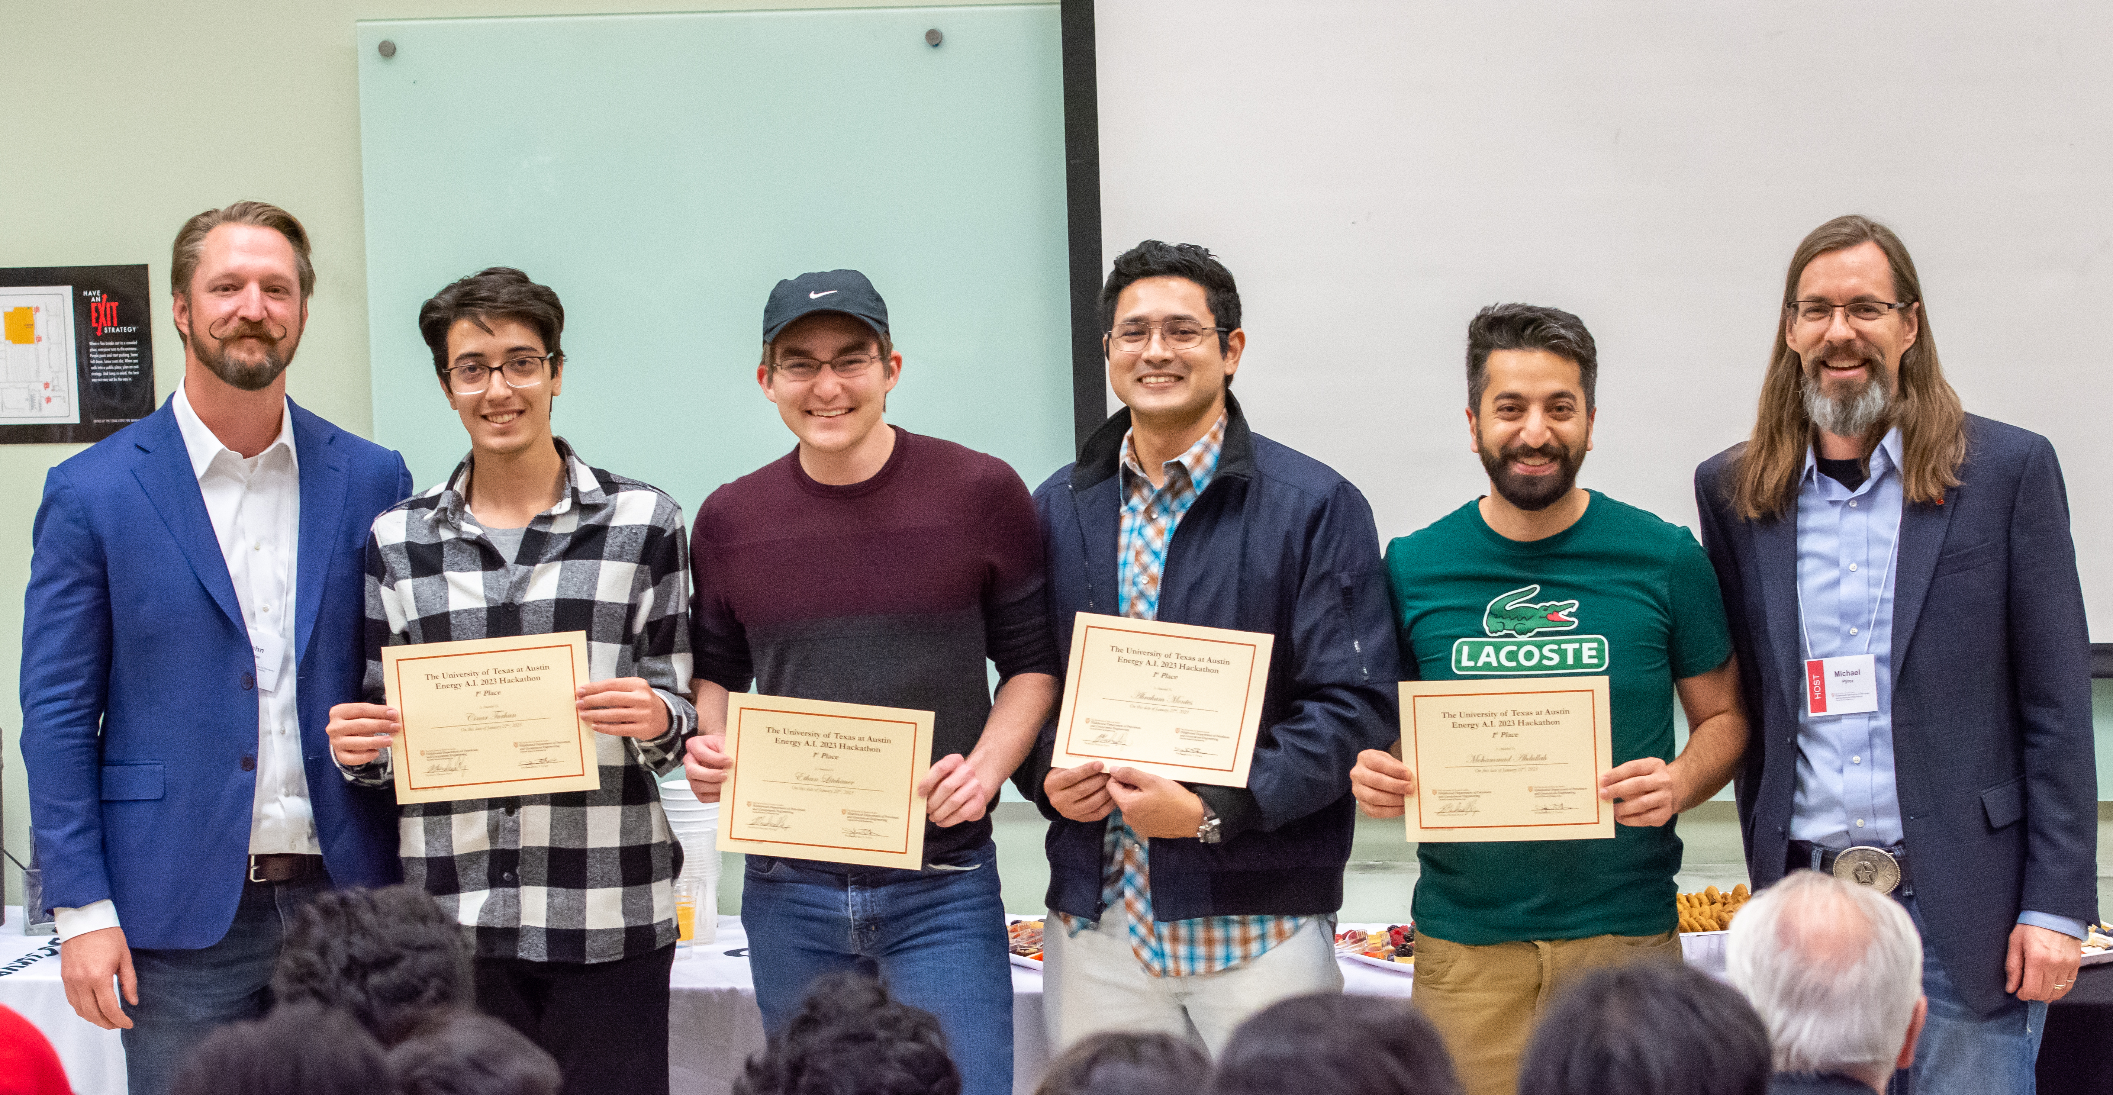
Introduction
Hacker
Studies and Department
Research
Çinar Turhan Master’s student PGE Well repurposing
Ethan Litchauer Undergraduate student ECE Integrated circuits
Abraham Montes PhD student PGE Stuck pipe prediction & analysis
Mohammad Abdullah PhD student PGE Reservoir simulation

Slide 4
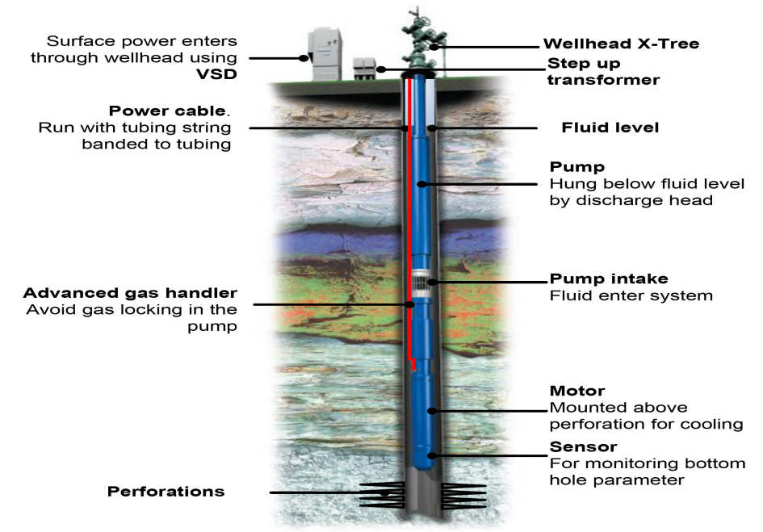
Why does it matter?
Logistics
Preventive maintenance
Aid design enhancement: RCA
Rig job scheduling
[Nuñez et al 2014]

Slide 5
Work breakdown
Literature Review
Exploratory Data Analysis
Model Selection
Feature Engineering
Model

Slide 6
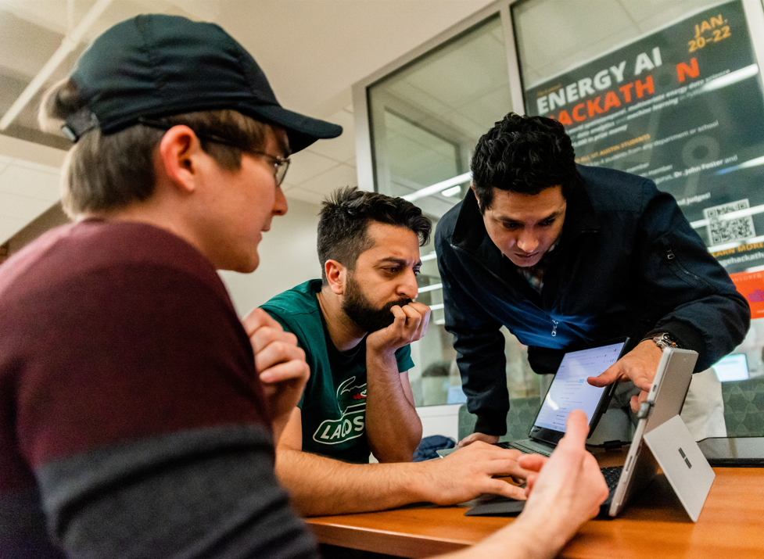
Work breakdown
Literature Review
Finding databases
Search based on title and abstract
Filtering the common features used in previous studies

Slide 7
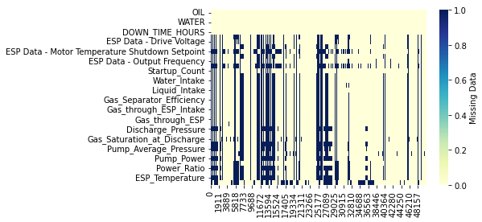
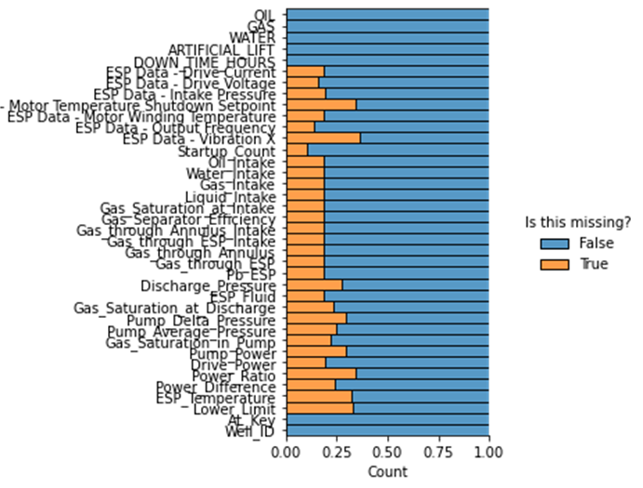
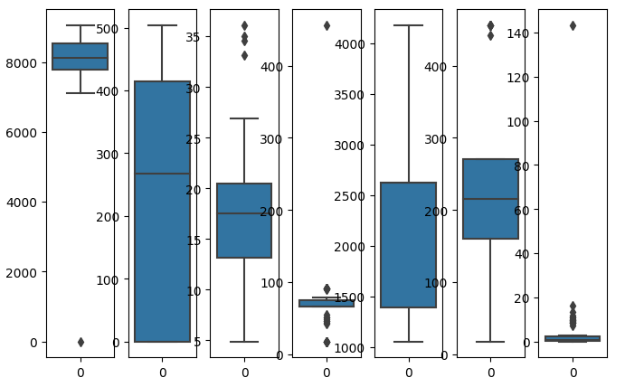
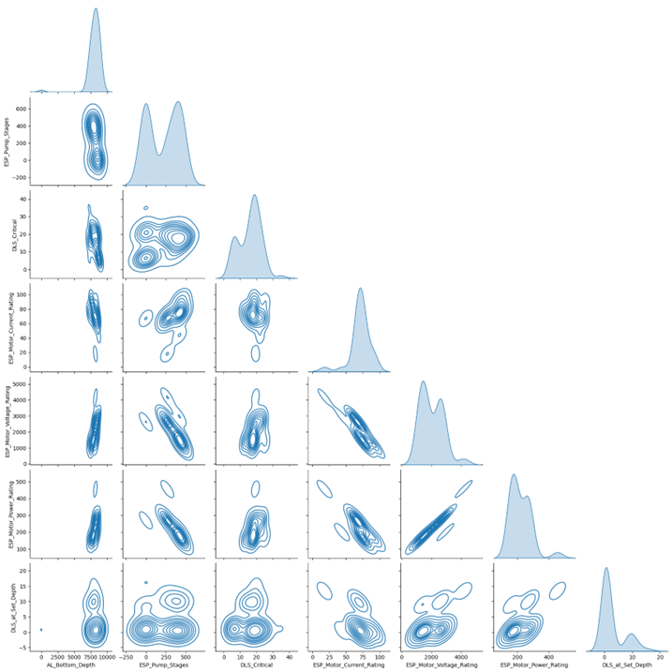
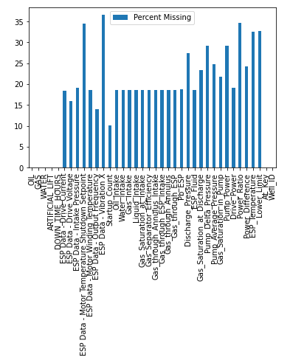
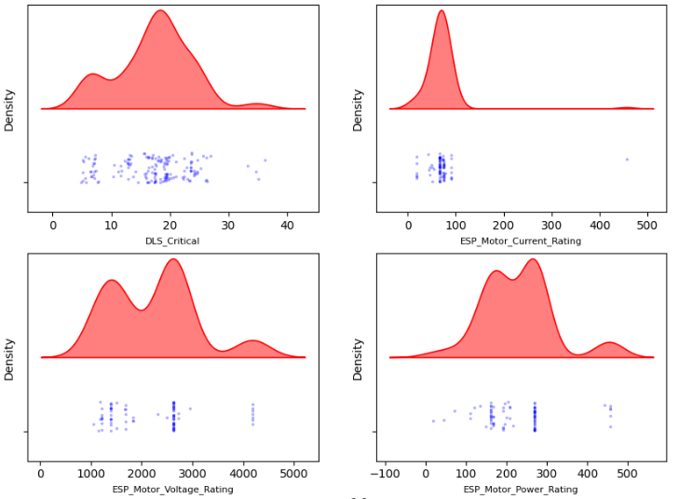
Work breakdown
Data is gold, right?
Exploratory Data Analysis
Data Completeness
Pairplots
Correlations
Outliers
Distributions

Slide 8
Work breakdown
Data is gold, right?

Slide 9
Work breakdown
Model Selection
Finding databases
Search based on title and abstract
Filtering the common features used in previous studies

Slide 10
Project Workflow
Literature Review
Exploratory Data Analysis
Model Selection
Feature Engineering
Model

Slide 11
Model
Literature Review
Model
Random Forest
.
.
.
.
.
.
.
Exploratory Data Analysis
Feature Engineering
Model Selection

Slide 12
How we hacked it
Feature selection :
36 + 14 to 10 only
WOR
GOR
Frequency
ESP Current E
ESP Voltage
Gas intake
Gas through Annulus
Pump DP
Power difference
ESP Temp.
Filter Data/Feature Selection
Sliding Window/SVM
Iteration Updates/K-Folds

Slide 13
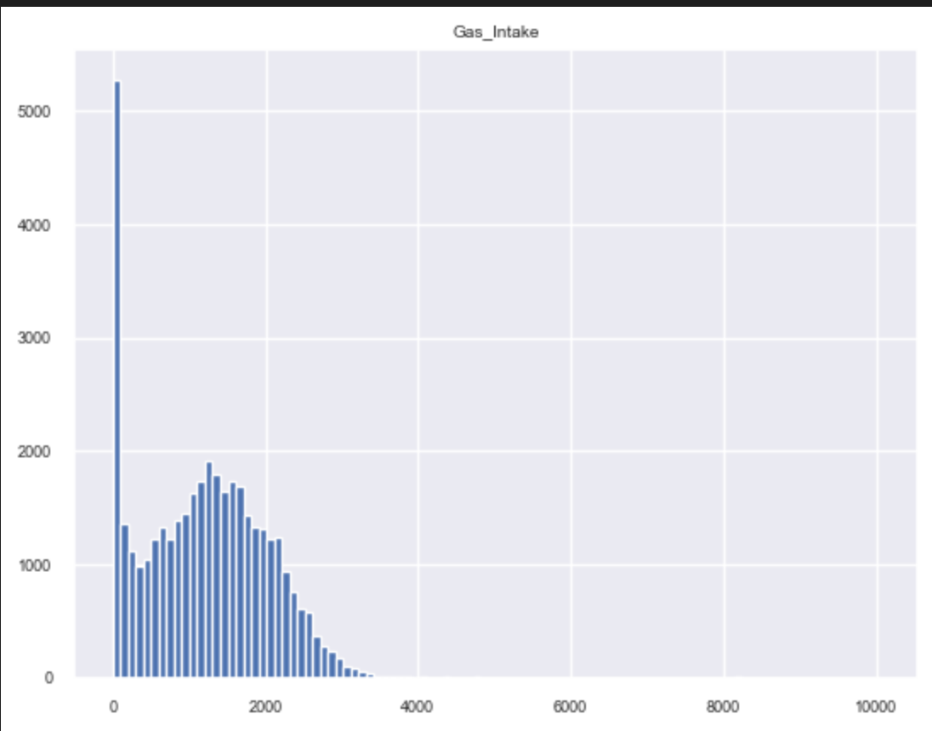
Some natural occurring zero-inflation that requires domain expertise
Filter Data/Feature Selection
Sliding Window/SVM
Iteration Updates/K-Folds
Gas Intake

Slide 14
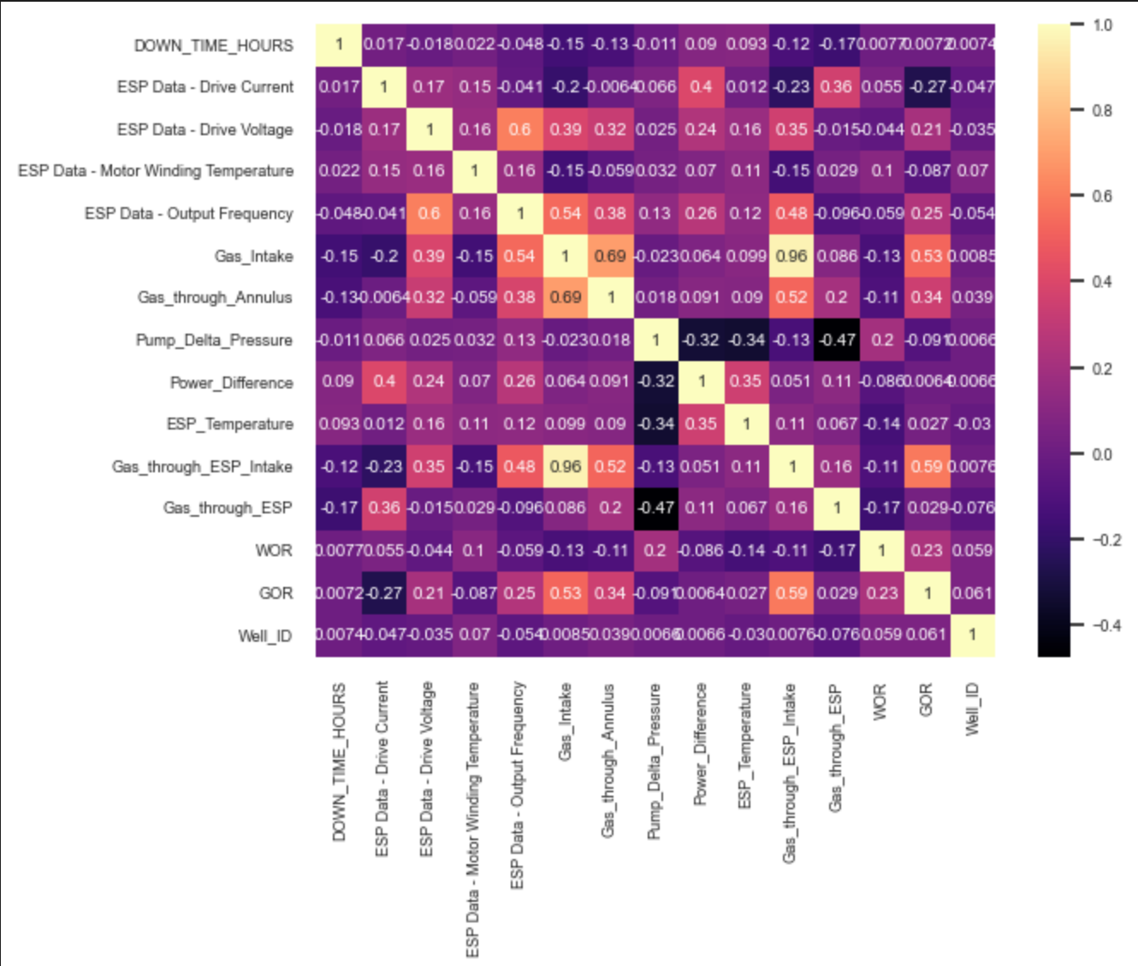
Domain expertise is not the only thing
Filter Data/Feature Selection
Sliding Window/SVM
Iteration Updates/K-Folds

Slide 15
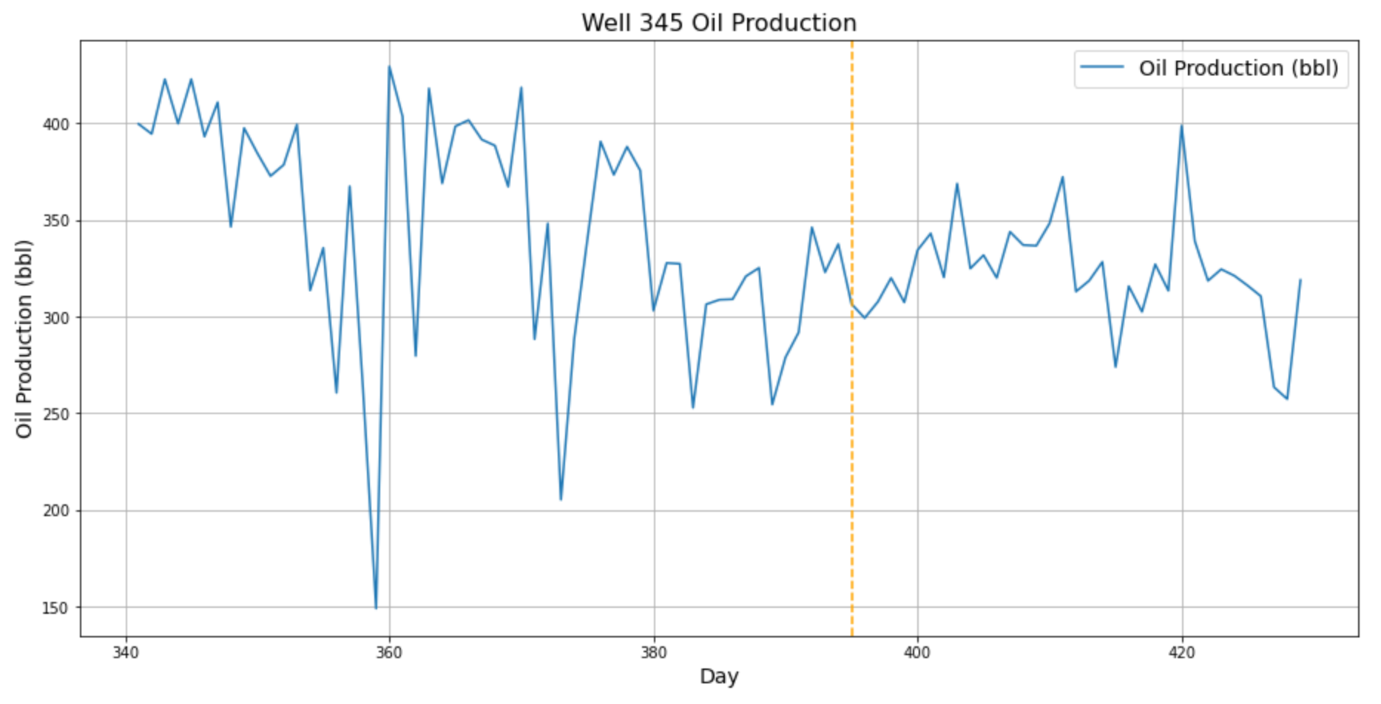
Feature engineering and
setting up a classification problem
Filter Data/Feature Selection
Sliding Window/SVM
Iteration Updates/K-Folds
30 Days
Mean, variance and kurtosis
There is a trade-off

Slide 16
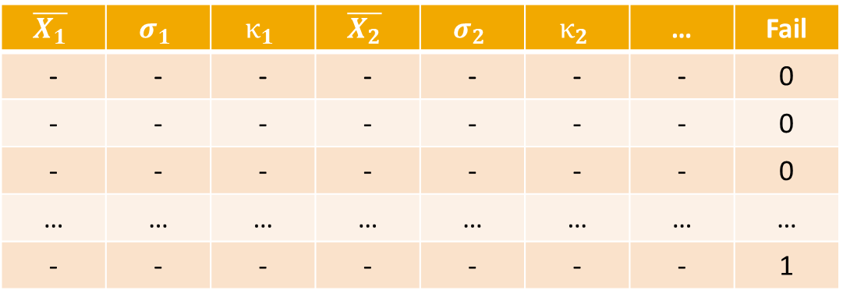
The imbalance problem
$$\overline{X_{1}}$$ | $$σ_{1}$$ | $$κ_{1}$$ | $$\overline{X_{2}}$$ | $$σ_{2}$$ | $$κ_{2}$$ | … | Fail
- | - | - | - | - | - | - | 0
- | - | - | - | - | - | - | 0
- | - | - | - | - | - | - | 0
… | … | … | … | … | … | … | …
- | - | - | - | - | - | - | 1

Slide 17
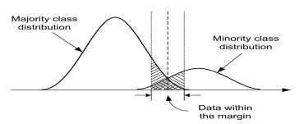
Dealing with imbalance
Undersampling the majority class
Random undersampling
Accuracy alone was not our guiding star
What about oversampling and other sophisticated methods?
[He & Garcia 2009]

Slide 18
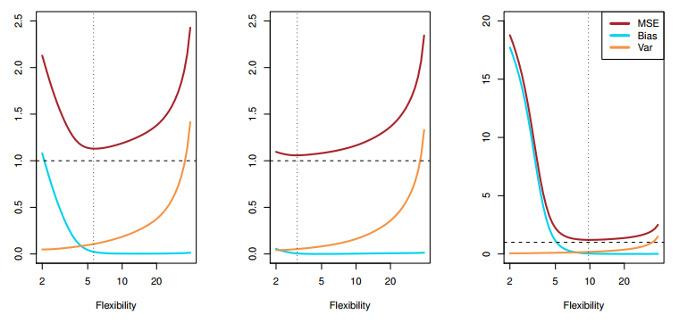
How we would hack it again
Increase the search space
$$E{\left[y_{0}−\hat{f}\left(x_{0}\right)\right]}^{2}=Var\left(\hat{f}\left(x_{0}\right)\right)+{\left[Bias\left(\hat{f}\left(x_{0}\right)\right)\right]}^{2}+Var\left(ε\right)$$
Model space: There is no free lunch.
Parameters and Hyperparameters: Informed search, instead of brute force.
Is the irreducible really irreducible?
The covariogram (what about the
window size?)
[James et al 2017]

Slide 19
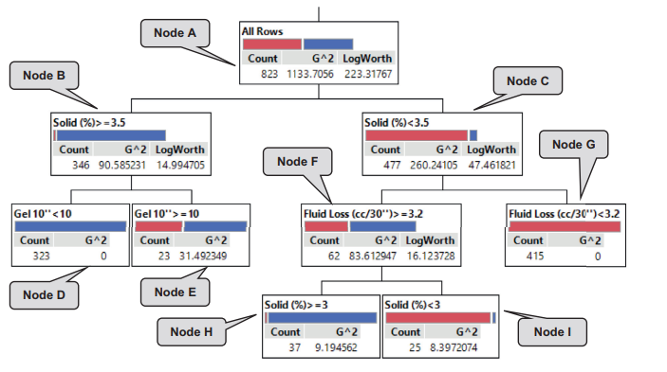
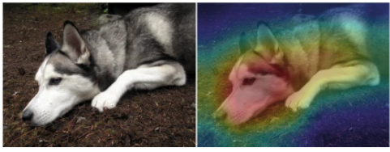
How we would hack it again
High-stakes decisions require interpretability
Explainable ML
Inherently Interpretable ML
[Rudin, et al 2019]
[Al Dushaishi, et al 2019]

Slide 20
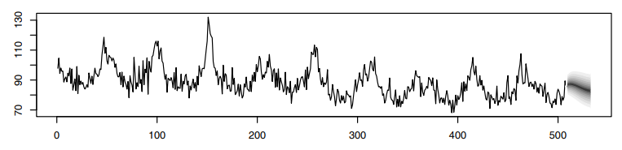

How we would hack it again
High-stakes decisions require to go beyond binary response
$$z_{t}\sim N\left(α z_{t−1}, σ^{2}\right)$$
$$α\sim N\left(μ_{α},σ_{α}^{2}\right)$$
$$σ^{2}\sim IG\left(μ_{α},σ_{α}^{2}\right)$$
[Shumway & Stoffer 2011]

Slide 21
Wrap up
Why the problem matters: Cost reduction
Work breakdown: Divide and succeed.
Data pre-processing tortuosity: Engineering the dataset.
Data imbalance: Undersampling approach.
Drillpy 2.0:
Widening the search space (e.g., model, window size).
Improved optimization of complexity and parameters.
Exploring distinct feature spaces.
Interpretability and uncertainty.

Slide 22
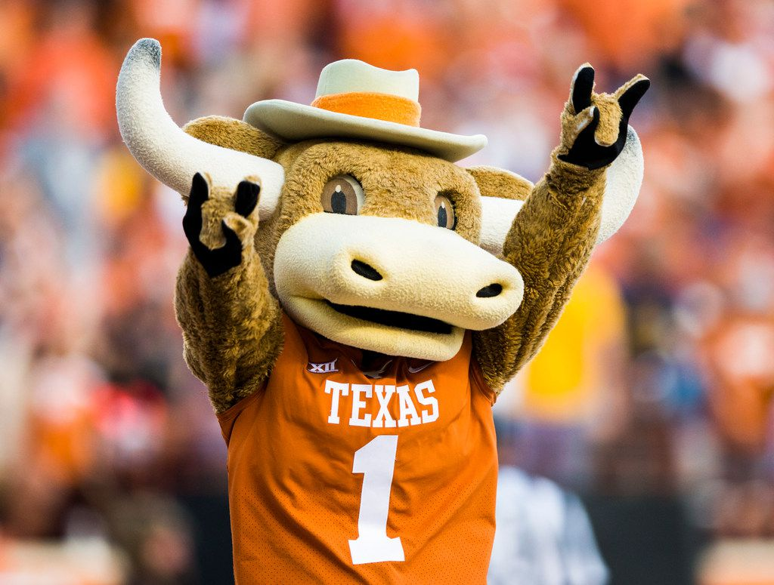
Thank you!!! Questions?

